Slide 1
An Electric Craving
UCSD Data Science and Programming Bootcamp
Project One
Jacob Zacarias
Sanabu Washizuka
Tanlin Hung
Walaa Alani

Slide 2
Introduction
"Todd"
Lives in San Diego, CA
Enjoys rock climbing
A foodie
Looking to buy a new car
(FIND CLIPART/DRAWING/PHOTO OF RANDOM GUY AND INSERT HERE. ENSURE THE ART IS FREE USE.)

Slide 3
Theme of the Study
Should I get an electric vehicle over a gas-powered car?

Slide 4
EV or Gas Car?
Q1. Will I be able to find charging stations wherever I am?
Q2. Out of both categories (EVs and gas-powered cars) which make and model is the most cost-effective for their fuel?
Q3. Will EVs really pay themselves off?
Q4. What factors might hint that a city has a lot of charging stations?
Q5. How much will I save on a trip?

Slide 5
Brief Summary of findings
Q1. Will I be able to find charging stations wherever I am?
(summary here?)
Q2. Out of both categories (EVs and gas-powered cars) which make and model is the most cost-effective for their fuel?
(summary here?)
Q3. Will EVs really pay themselves off?
(summary here?)
Q4. What factors might hint that a city has a lot of charging stations?
(summary here?)
Q5. How much will I save on a trip?
(summary here?)

Slide 6
Q2. Out of both categories (EVs and gas-powered cars) which make and model is the most cost-effective for their fuel?
Electric Vehicles VS
Gas Powered Cars
We decided to create a data frame that showed the differential prices in the first year between the gas and electric vehicles. There are two versions to the data frame as we compare the top selling vehicle EV and Gas in the US and the top selling EV and Gas in each state.

Slide 7
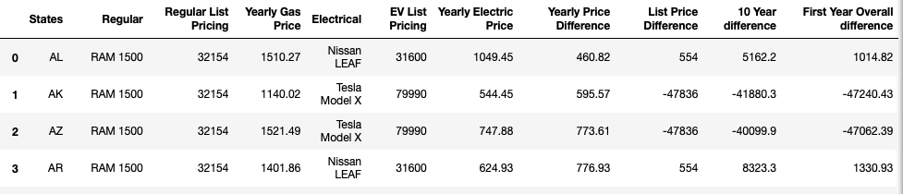
Q2 Pt 2 The Two types of Graphs
Top selling EV and Car in the US compared in each state
Top selling EV and Gas in each state comparison

Slide 8
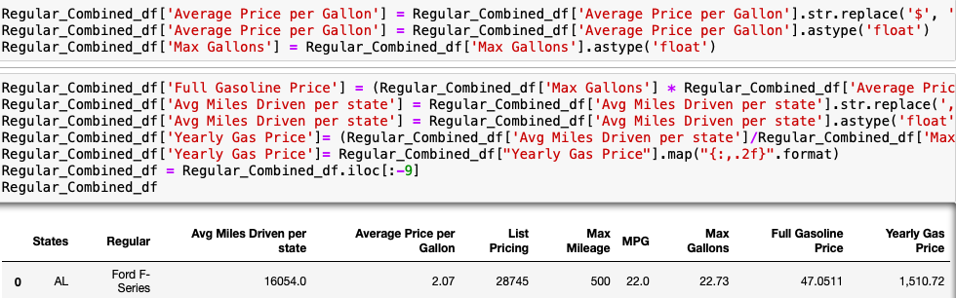
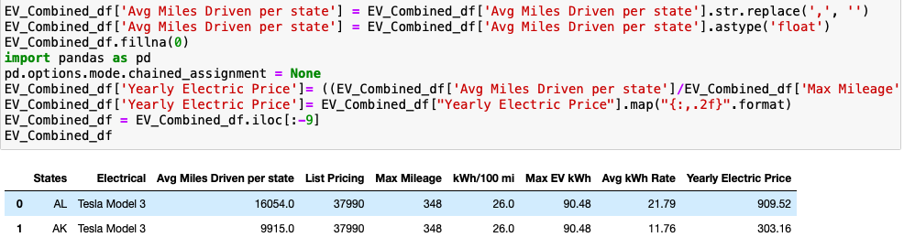
Q2 pt 3 Coding process
Coding Process to receive the Yearly gas and EV price for each state
Tesla 3 vs Ford F series

Slide 9
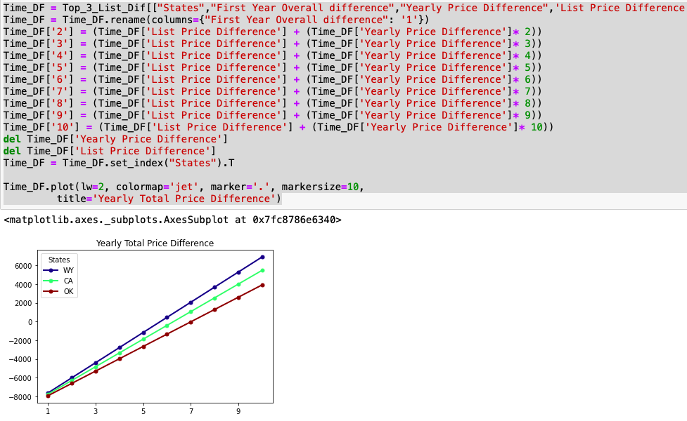
Q2 pt 4 Coding
Coding for 10 year graph of total yearly price difference.

Slide 10
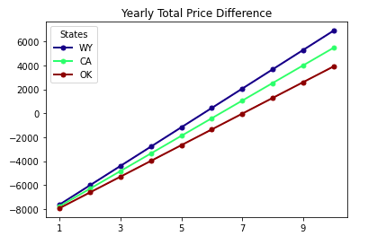
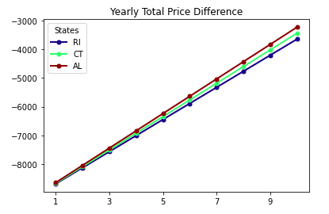
Q2 pt 5 Tesla 3 vs Ford F Series
Years it takes for Tesla to payout the Price Difference
Top 3 States
Bottom 3 States

Slide 11
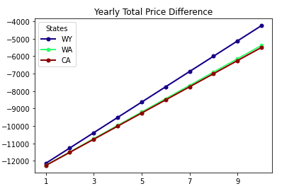
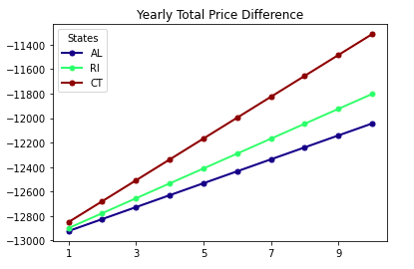
Q2 pt 5 Tesla 3 vs Ford F Series
Years it takes for Tesla to payout the Price Difference
Top 3 States
Bottom 3 States

Slide 12
Q2 Will EVs really pay themselves off?
With the code we ran we were able to find if the Tesla 3 with a selling Price of $37,990 will be able to pay off
The difference in prices between the Ford F-Series and the Toyota Camry.
For the top three states like Wyoming, California and Oklahoma the EV owner will actually make a net positive
over 3k from the differential pricing.
For the bottom three states that is Rhode Island, Connecticut , and Alabama the Ev owners would be
a few thousand dollars behind the breaking point to even out the price differences.
When it comes down to the Toyota Camry, EV owners would be 4 to 6 thousand dollars away from reaching
the breaking point.
The price difference between the Tesla 3 and the Toyota Camry in the top three states were 4 k to 6k away
from reaching the breakpoint in a ten year span.
For the the worst three states you would barely make 2k back.
The reasons for this big disparity is do to the affordable fuel efficient costs of the Toyota Camry that minimize
the cheap fuel alternative the EV’s provide

Slide 13
Q.4 What factors might hint that a city has plentiful charging stations?
"If I were to move or travel elsewhere, what factors could I look at to see how reliably I can find a charge station?"
In other words, what properties of a city correlates with how many charge stations are available there?

Slide 14
Q.4 Correlational Study
Correlational Study of the "No. of Charge Stations" against other factors within a city
Review "No. of Charge Stations" against :
City Population Density
Gas Prices (CA only study)
Institution type 1 (to be named later)
Institution type 2 (to be named later)

Slide 15
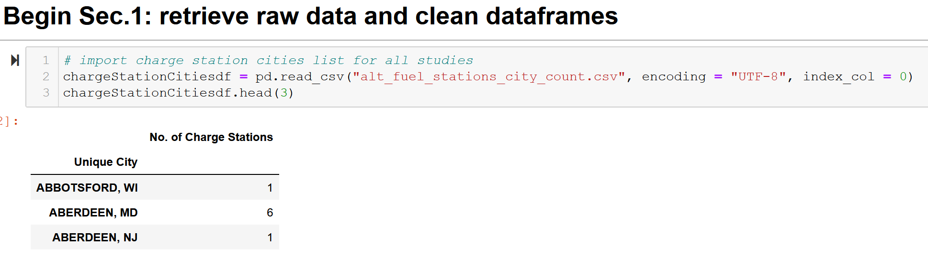
Q.4.1 – Charging Station List

Slide 16
Q.4.1 - City List and City Population Density (cleaning)
Source:
https://simplemaps.com/data/us-cities
General Info:
Information on cities in the U.S.
Updated as of November 18, 2020
Over 108,000 cities and towns from all 50 states
Population Density per city

Slide 17
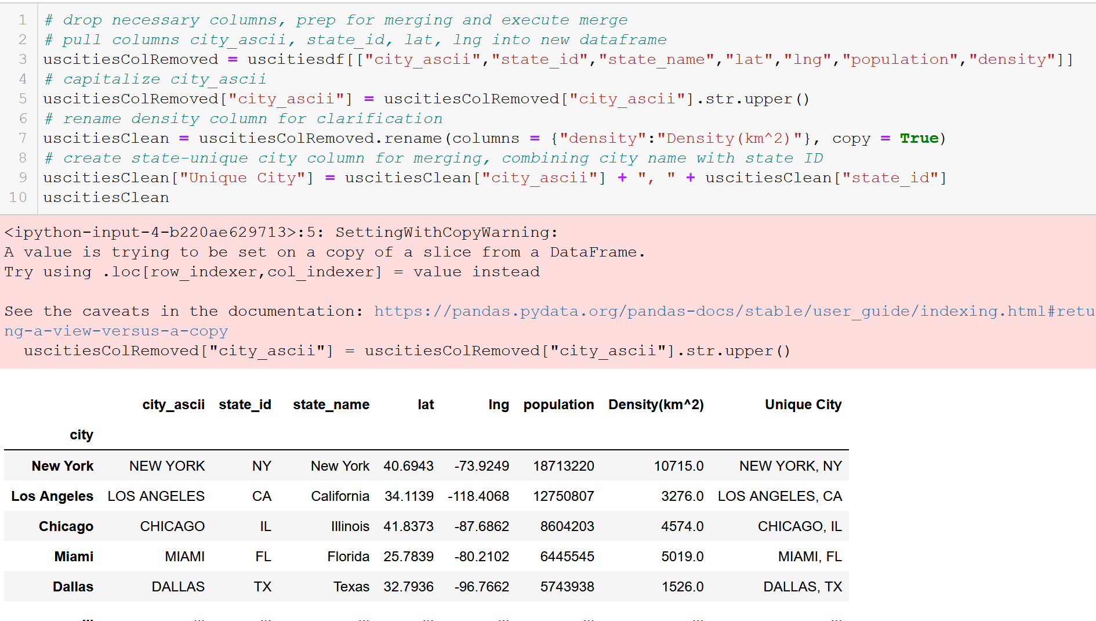
Q.4.1 - City List and City Population Density (cleaning)
*Note line 9

Slide 18
Q.4.1 – Urban Areas (cleaning)
Source:
https://en.wikipedia.org/wiki/List_of_United_States_urban_areas
General Info:
A list of urban areas in the United States as defined by the United States Census Bureau
An urbanized area (UA) is an urban area with population over 50,000
Used to limit cities to observe for API call

Slide 19
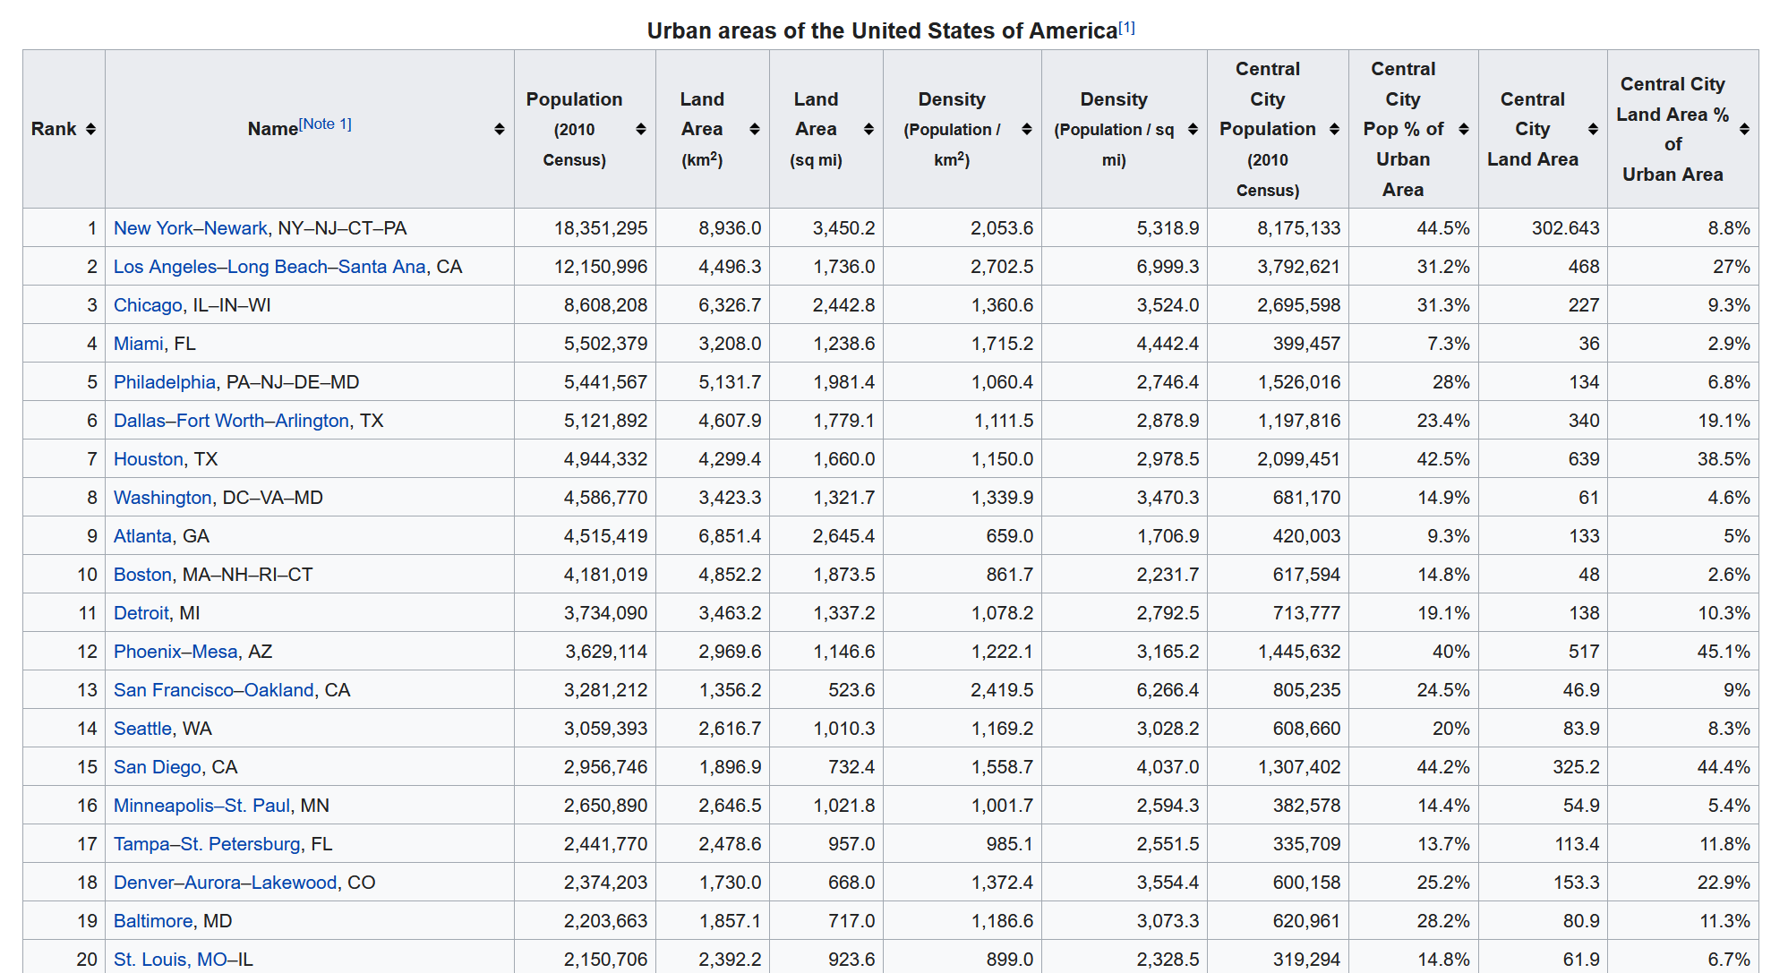
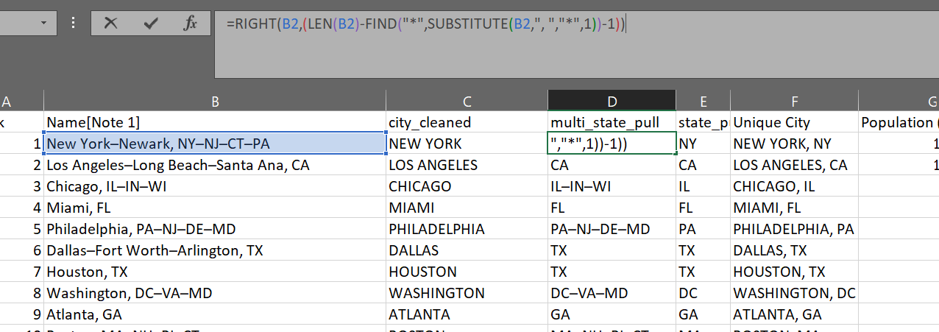
Q.4.1 - City List and City Population Density (cleaning)
Creating state-unique city names within Excel for merging

Slide 20
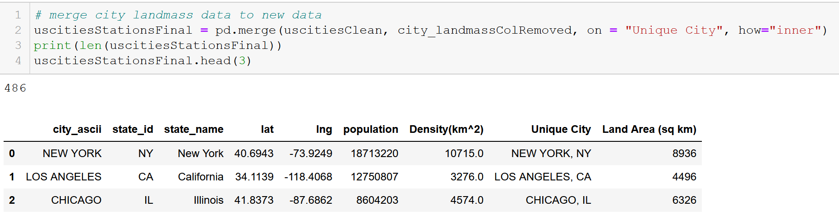
Q.4.1 – Merge to limit city count

Slide 21
An Electric Craving
UCSD Data Science and Programming Bootcamp
Project One
Jacob Zacarias
Sanabu Washizuka
Tanlin Hung
Walaa Alani

Slide 22
Topic Slide
CONTENT HERE

Slide 23
Subtitle
CONTENT HERE

